Slide 1
‘Right Place Right Time’
Capstone Project : Manju Nair

Slide 2
Table of Contents
Summary
Context
PASSNYC’s ‘Data Science For Good Challenge’
‘ Right Place Right Time ‘
Datasets And Data Wrangling
Exploratory Data Analysis – Findings
Approach For Data Modeling
Data Modeling
Analysis Of Results
Future Work

Slide 3
Summary
PassNYC’s ‘Data science for Good challenge’ seeks to use the power of data science to improve its “Outreach " program which enables students from weaker socio-economic backgrounds qualify in SHSAT(exam) and receive placements in specialized high schools(SPHS).
Findings : Middle schools sending qualifying students to Specialized High Schools(SPHS) are strikingly different in socio-economic distribution , from schools having non-qualifying students
Results:
1.) Furnishes list of middle schools having eligible candidates who will benefit from PASSNYC’s training, as easily locatable plot on a map for ease
2.)Provides list of middle schools where SPHS program and the entrance exam SHSAT can be popularized, to increase the number of test takers from schools, as easily locatable map plots with information display
‘Right Place Right Time’ project aims to solve this challenge by deploying in-depth analysis using machine learning techniques , to predict the list of schools that PASSNYC can focus on , for maximum impact with its ‘Outreach’ program.
Future Work : Further categorize list of schools , based on geography/ Burroughs of NYC, average school income, ELA and math scores, to custom-tailor training based on the requirements of each of these groups.

Slide 4
Context
Entry to New York City’s eight ultracompetitive specialized public high schools(SPHS) for 8th graders is through a common entrance exam(SHSAT).
Out of 600 public middle schools, just 10 account for more than 25 percent**, of the offers to attend one of these elite schools.
Though the larger body of NYC’s school system is two-thirds Hispanic and Black, it is interesting to note that these 10 middle schools are disproportionately Asian and White.
Also worth noting is the fact that at the top 10 schools ,70% of students take SHSAT**, whereas on an average in any other middle school in NYC, 35% of students take SHSAT**.
There has been demands from all walks of society to build pressure on the city’s governing council to take steps to increase the diversity of students gaining admission to these high schools
**Source : Education Department data

Slide 5
PASSNYC‘s ‘Data Science for Good Challenge’
PASSNYC is a not for profit organization that aims to increase the diversity of students taking and qualifying in SHSAT.
With its `Data Science for Good Challenge’ ,PASSNYC aims to use the power of data science to increase the effectiveness of its current ‘Outreach’ program, which
Identifies suitable schools and coaches its eligible students from economically and socially backward backgrounds , enabling them to qualify in SHSAT
focuses efforts in popularizing ‘SHSAT’ and ‘SPHS’ in schools located in under-performing areas that are historically underrepresented in SHSAT registration

Slide 6
’ Right Place Right Time’ Project
‘Right Place Right Time’ project solves this challenge by
Analyzing the existing publicly available relevant data sets to observe significant patterns and correlations amongst the various features
Using ensemble methods to find the most important features influencing the selection criteria for candidates in SHSAT the most
Designing a robust machine learning model to successfully predict separate lists of schools requiring training and awareness creation sessions, that PASSNYC can focus on for maximum impact.

Slide 7
Datasets and Data Wrangling
Data sets
2016 School Explorer data which has all the demographic data about the NYC schools, contained in 1272 Rows and x 161columns
2013_-_2018_Demographic_Snapshot_School which give demographic details from the past 5 years
SHSAT_Admissions_Test_Offers_By_Sending_School for three academic years that contains details like number of test takers, no of offers received and number of students in class for each of the schools
Data Wrangling
Some unnecessary attributes were dropped to reduce dimensionality and a couple of new columns introduced to calculate scores
For some columns, the value that were categorizations like ‘ Meeting ’, Approaching and ‘ Exceeded’ ‘Target’ were converted to numeric ranking ‘1’,’2’,’3’.
Function to strip ‘$’ and ‘%’ in columns
Fill missing values with mean value where applicable
Dropping NaN values where it was significantly small ore replacing with 0 as applicable

Slide 8
Exploratory Data Analysis – Findings (1/3)
SHSAT offer Ratio
Black- Hispanic Population
SHSAT offer Distribution
White - Asian Population
The Offer ratio plotted against both the population sets also have a correlation coefficient of around 60% only.
However it is interesting to note that the offer ratio goes up as the White- Asian population in schools go up, whereas, for the Black Hispanic population, with the increase in population, the offer rate was coming down

Slide 9
Exploratory Data Analysis – Findings (2/3)
SHSAT offer Distribution
ELA 4s Students
SHSAT offer Distribution
Math 4s Students
The Offer ratio plotted against both the ELA 4s scores and Math 4s scores of all the middle schools
It can be noted from the scatterplot, the ELA 4s and Math 4s scores show a somewhat substantial correlation with the Offers received from SPHS.

Slide 10
Exploratory Data Analysis – Findings (3/3)
ENI Distribution Feeder** and Non–feeder schools **
Mean ENI of Feeder schools - 42.44
Black-Hispanic Distribution in Feeder and Non-feeder schools
Mean Black-Hispanic Population at Feeder schools - 38.94
Scatterplot of ENI and Bl- Hi Distribution
Feeder schools have low ENI & Bi-Hi %
Non-feeder schools have high ENI & Bi- Hi %
Mean ENI of Non Feeder schools - 69.87
Mean Black-Hispanic Population at Non Feeder schools - 86.35
Feeder and non-feeder schools are strikingly different in terms of their racial composition and economic need level
The scatterplot above visualizes the positive correlation (r = 0.78) between ENI and % Black and Hispanic students.
Feeder schools (larger-sized blue points) tend to have low-to-medium ENI and lower proportion of Black or Hispanic students, while non-feeder schools (gray points) cluster around the upper right corner of the plot
** Feeder schools –are the ones with 5 or more students qualifying in SHSAT exams
** Non Feeder schools - and Non-Feeder schools are ones with 0-5 students qualifying in SHSAT

Slide 11
Approach for Data Modeling
Two steps in the program are
To identify schools(currently non-feeder schools) with academically qualified students, which would benefit from training programs. Currently, atleast some students in these schools are taking SHSAT but without good results.
To identify schools where the awareness of SHSAT is less and there are not many test takers. In such schools PASSNYC can do road shows and immersion programs to popularize the program and its benefits.
For all schools,
Need_Training_Score = 'number of offers received in a school' /
‘total number of students in the school',
with a lower score indicating a for training requirement for the school.
Need_Awareness_Score = 'number of test takers in the school' /
' total number of students in the school' .
Training_Need_Score and Awareness_Need_Score are later classified into 0 or 1 based on score value to make the target variable a classifier.

Slide 12
Data Modeling
Using machine learning algorithm to create a model to classify the list of schools into
ones requiring training or not and
ones requiring awareness creation sessions or not
Random Forest ensemble is used to do Feature Selection -- there are close to 50 feature variables and feature importance can be done and features prioritized
Random Forest Classifier is used for machine learning and modeling the training data
The model is then used to predict the result on test data

Slide 13
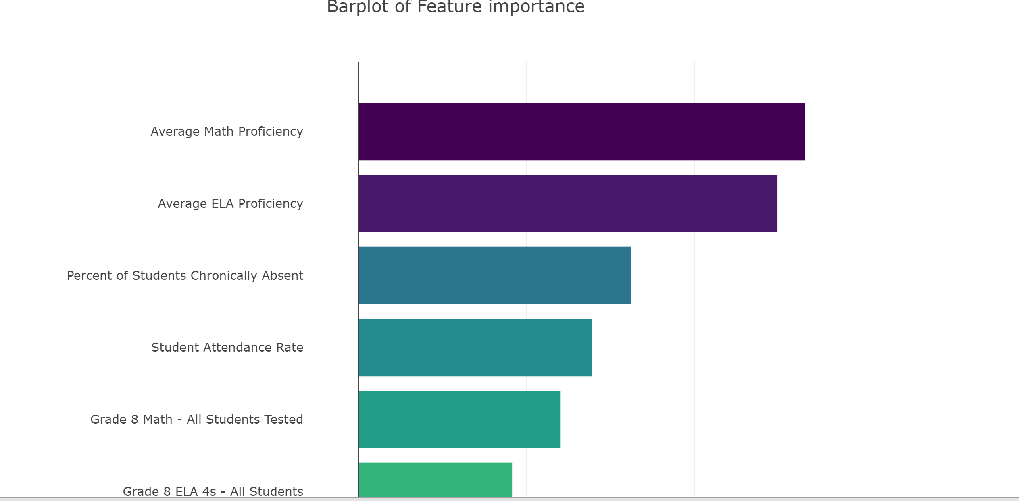
Data Modeling
Bar plot of feature importance

Slide 14
Data Modeling
Random Forest Classifier
Using the Random Forest Classifier gives a Mean Absolute Error of 0.08 which is very
minimal and the cross validation score is 0.9, which ensures a good prediction,
as the model ensures a 91% accuracy in prediction.
We can use this Classifier to create two separate list of schools that need help with
1.) training and
2.) awareness creation
respectively , from the 'School Test' data
Using this prediction model, we can predict whether any public middle school in NYC would make it to the list of PASSNYC's training required or Awareness required lists, if we have schools' students' performance data and other feature data.

Slide 15
Analysis of Results
Results from prediction on test data (1/2)
Training Required or not List
Map with schools as icons- information display on hover

Slide 16
Analysis of Results
Awareness session required or not - list
Map with schools as icons- information display on hover
Results from prediction on test data (2/2)

Slide 17
Future Work
The list of schools can be further categorized , based on
geography/ Burroughs of NYC
based on the average school income
ELA and math scores and ranking given or grouped up ,
so that training plans can be tailored according to the needs of each of these groups.

Slide 18
Thank You
Acknowledgments
Srdjan Santic
Andrea Constantinof

